Slide 1
CSE2002 Theory of Computation and Compiler Design
MODULE - 4
Dr. WI. Sureshkumar
Associate Professor
School of Computer Science and Engineering (SCOPE)
VIT Vellore
wi.sureshkumar@vit.ac.in
SJT413A34

Slide 2
Constructing LALR Parsing Table
Method:
Input: An augmented grammar G’
Construct C = {I₀ , I₁ , I₂ , . . . , I_{n}} the collection of LR(1) items.
Among the set of LR(1) items, merge equivalent state into one.
After merging, let C’ = {J₀ , J₁ , J₂ , . . . , J_{m}} be the resulting sets of LR(1) items.
The parsing action for J is constructed in the same manner as canonical LR parsing table construction.
goto(J , X) = K, where J is the union of one or more items, i.e.,
J = I₁ U I₂ U . . . U I_{r} and K = goto(I₁ , X) U goto(I₂ , X). . . U goto(I_{r} , X)

Slide 3
Example: Given grammar G
S → CC (1)
C → cC (2)
C → d (3)
Augmented grammar G’
S’ → S
S → CC
C → cC
C → d

Slide 4
Collection of Canonical LR(1) Sets of Items
I₀ : S’ → .S , $ goto(I₀ , C) = I₂
S → .CC , $ I₂ : S → C.C , $
C → .cC , c/d C →.cC , $
C → .d , c/d C →.d , $
goto(I₀ , S) = I₁ goto(I₀ , c) = I₃
I₁ : S’ → S. , $ I₃ : C → c.C , c/d
C →.cC , c/d
C →.d , c/d

Slide 5
goto(I₀ , d) = I₄ goto(I₂ , d) = I₇ goto(I₃ , d) = I₄
I₄: C →d. , c/d I₇: C →d. , $
goto(I₂ , C) = I₅ goto(I₃ , C) = I₈ goto(I₆ , C) = I₉
I₅: S → CC. , $ I₈: C → cC. , c/d I₉: C → cC. , $
goto(I₂ , c) = I₆ goto(I₃ , c) = I₃ goto(I₆ , c) = I₆
I₆: C → c.C , $ I₃: C → c.C , c/d goto(I₆ , d) = I₇
C →.cC , $ C →.cC , c/d
C →.d , $ C →.d , c/d

Slide 6
I₃₆ = I₃ U I₆
I₃₆ : C → c.C , c/d/$
C →.cC , c/d/$
C →.d , c/d/$
I₄₇ : C →d. , c/d/$
I₈₉ : C → cC. , c/d/$
C’ ={I₀ , I₁ , I₂ , I₃₆ , I₄₇ , I₅ , I₈₉}

Slide 7
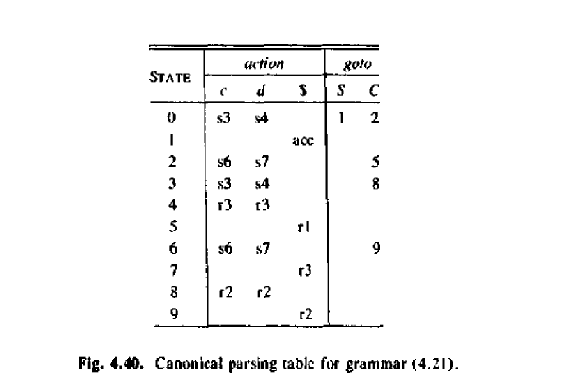

Slide 8
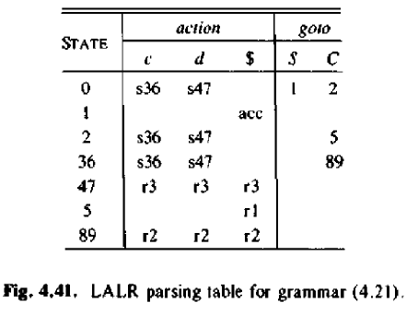

Slide 9
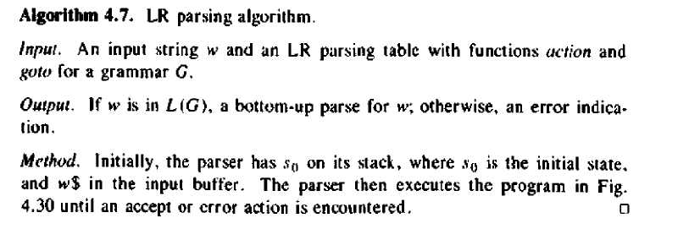

Slide 10
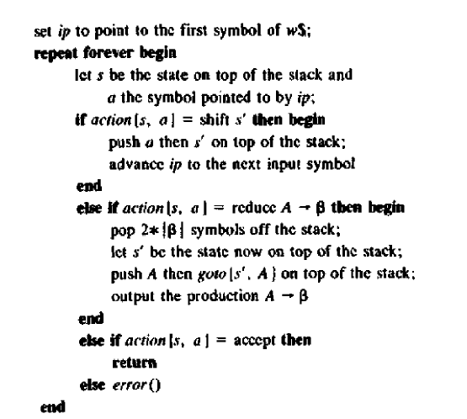

Slide 11
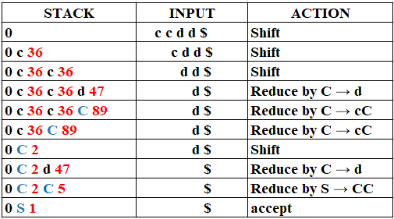

Slide 12
S
C
C
d
c
C
c
C
d

